Slide 1
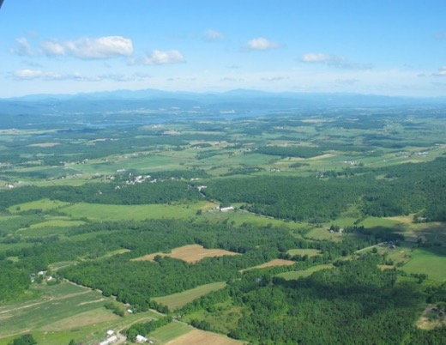
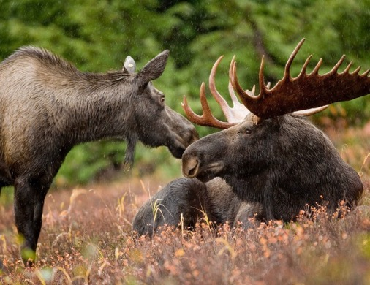
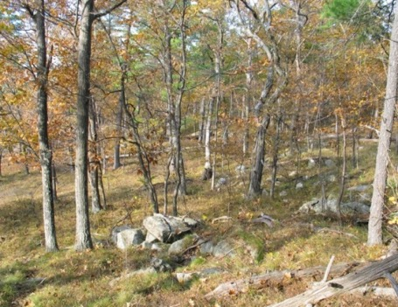
Vermont Conservation Design
A vision for an ecologically functional landscape
Caring for Our Home Grounds
The Center-West Ecoregion
November 2, 2019
Eric Sorenson

Slide 2
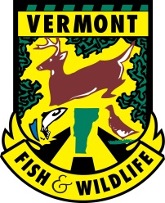
The Vermont Fish & Wildlife Department
The mission of the Vermont Fish & Wildlife Department is the conservation of our fish, wildlife, plants and their habitats
for the people of Vermont
Notes:
Problem with projector? Hit “Windows P”

Slide 3
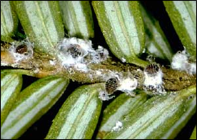
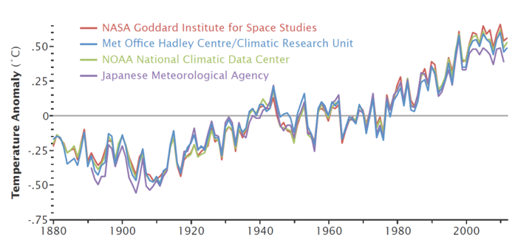
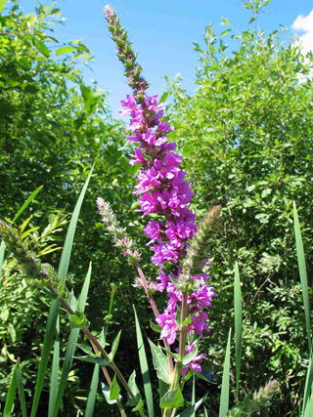
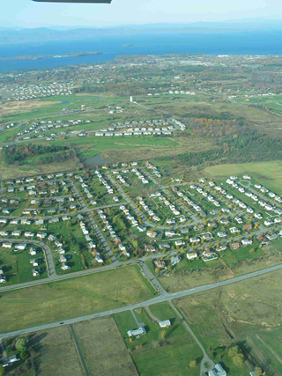
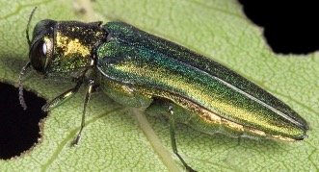
Threats to Biological Diversity
Population growth
Habitat loss
Habitat fragmentation
Non-native, invasive species
Climate change – direct and compounding effects
NASA
New!
Notes:
ES & JA

Slide 4
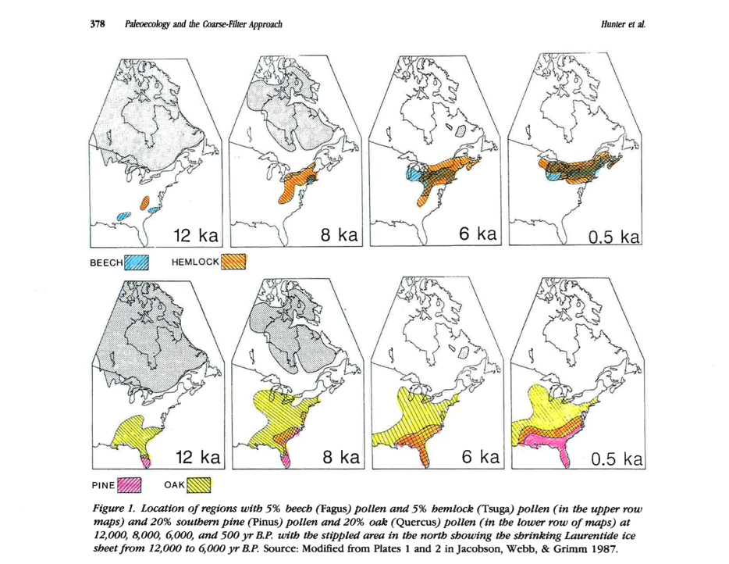
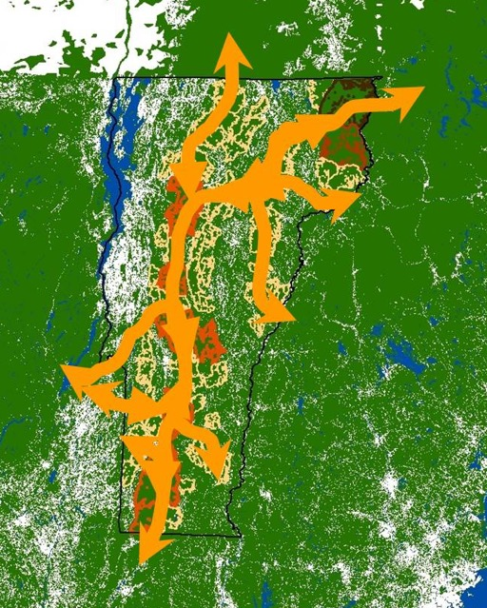
Climate Change
rapid and uncertain change
species will shift independently
need connectivity – species and processes
need to “conserve nature’s stage” – physical landscape

Slide 5
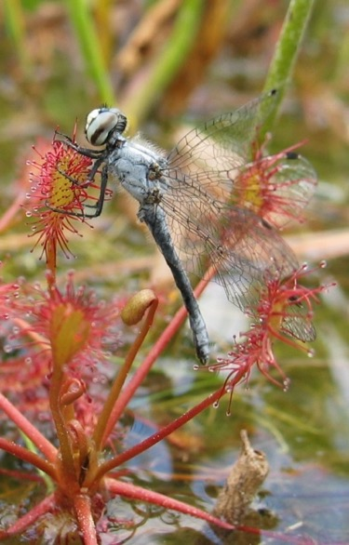
An estimated 24,000 to 43,500 species in Vermont!
How do we protect them all?
Elfin Skimmer

Slide 6
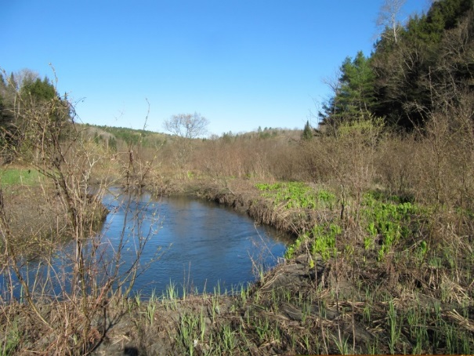
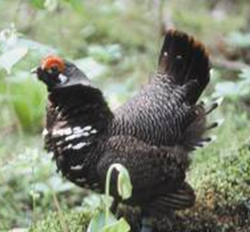
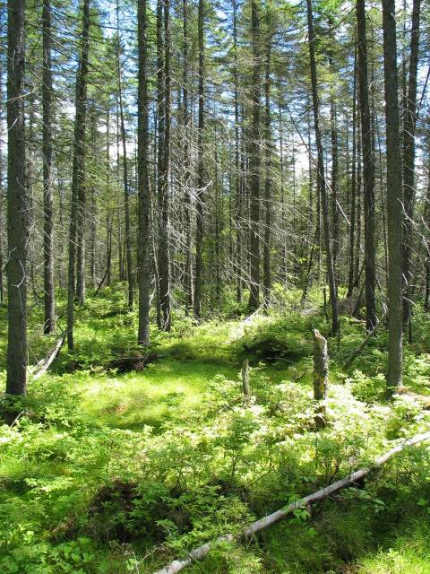
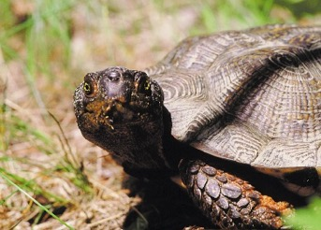
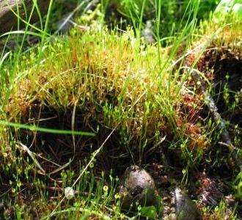
Coarse filter/fine filter approach to conservation
Well-recognized, efficient approach to conservation
Originally a combination of natural communities & species conservation efforts

Slide 7
We need coarser filters

Slide 8
Vermont Conservation Design
A practical, scientific vision for sustaining Vermont’s
ecologically functional landscape
for the future.
Applies the coarse filter-fine filter approach
Uses simple, recognizable features
Depends on thoughtful stewardship and management
Notes:
Ecologically functional landscape: large areas of connected forest, riparian areas, and natural communities that allow ecological processes to occur and species to access required habitat and shift across the landscape in response to climate change. Degree of functionality varies with landscape condition.

Slide 9
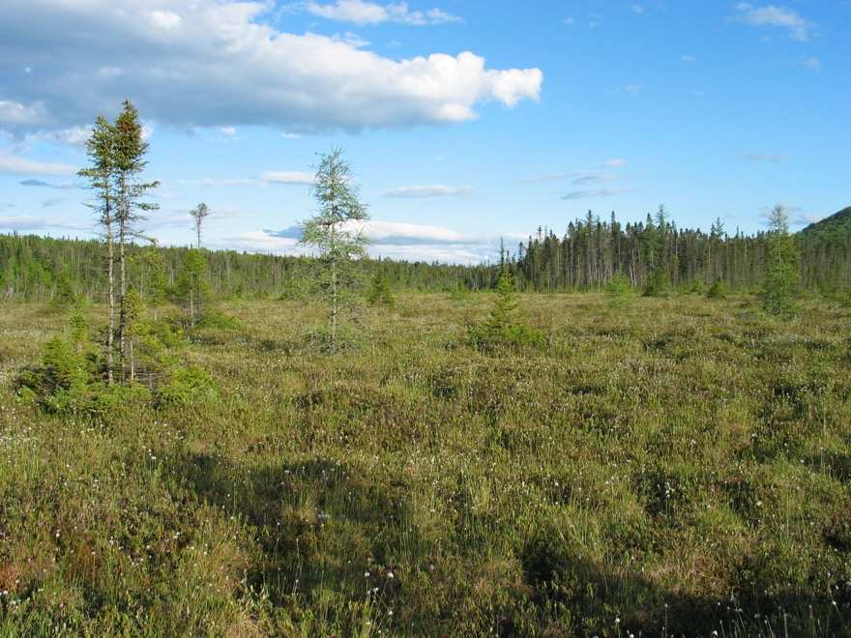
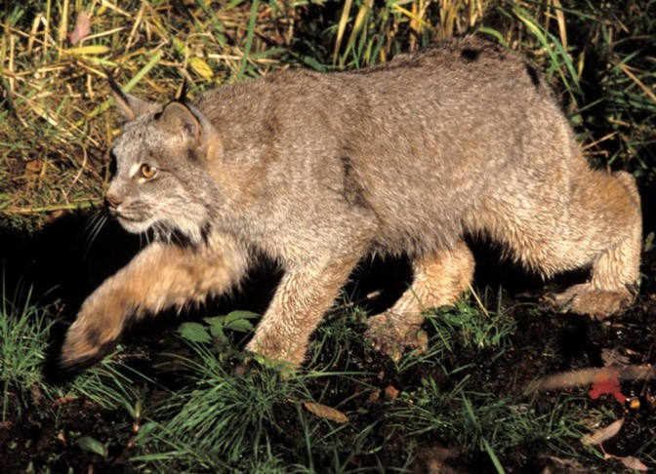
Collaborators: VT Fish and Wildlife Department
Vermont Land Trust
The Nature Conservancy
VT Department of Forests, Parks & Recreation
VT Department of Environmental Conservation
Northwoods Stewardship Center
USDA Natural Resources Conservation Service

Slide 10
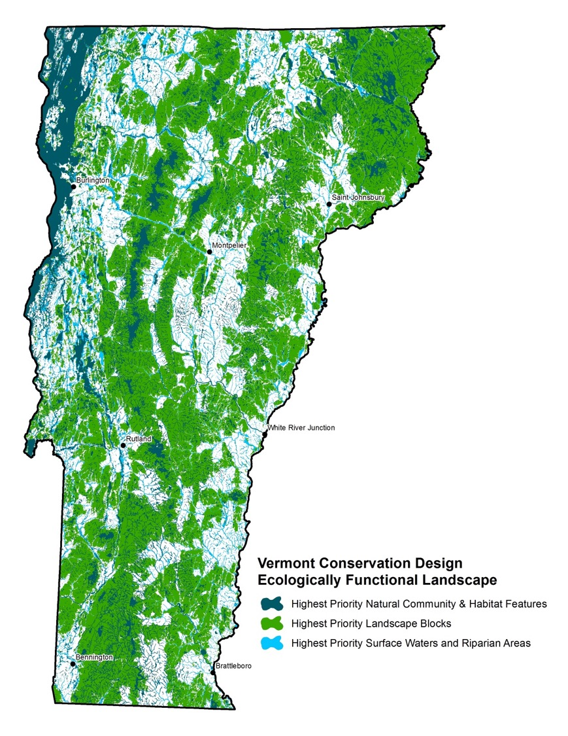
Ecologically Functional
Landscape
Intact
Connected
Diverse
A set of coarse-filter features which, if appropriately conserved and managed for their ecological functions, offer high confidence in maintaining biological diversity and ecological processes into the future.

Slide 11
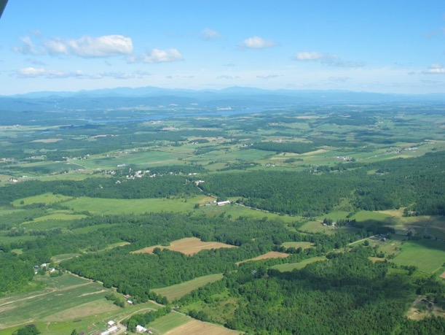
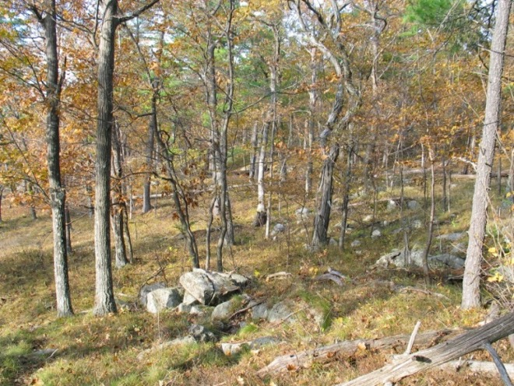
Conservation Design at Three Scales
Landscapes
Natural Communities
Species
Interior Forest Blocks
Connectivity Blocks
Surface Waters and Riparian Areas
Riparian Areas for Connectivity
Physical Landscapes
Wildlife Road Crossings
Natural Communities
Young and Old Forest
Aquatic Habitats
Wetlands
Grasslands/Shrublands
Underground Habitats
Species with very specific biological needs that will likely always require individual attention
Notes:
Review use of table to identify which species and natural communities are “captured” by each landscape element – refining the elements

Slide 12
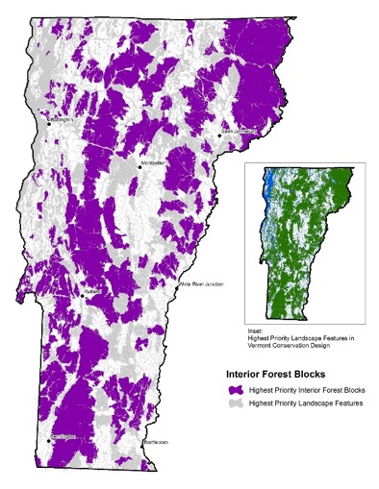
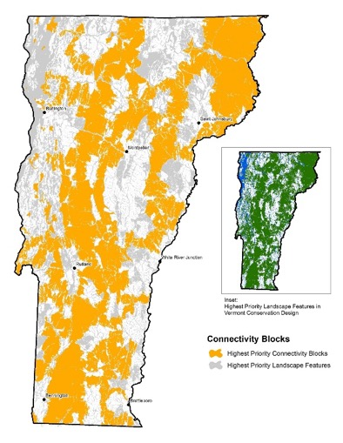
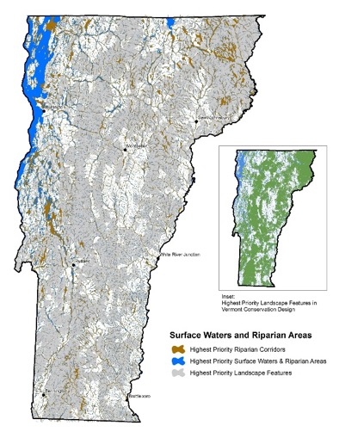
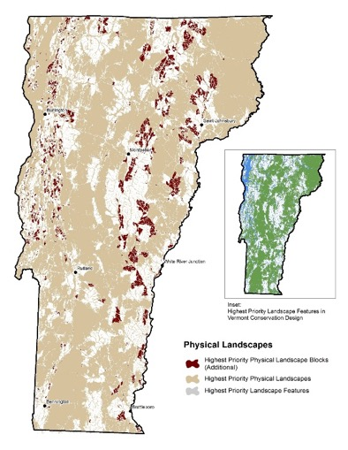
Intact and Connected Forest Blocks
Surface Waters and Riparian Areas
Interior Forest Blocks
Connectivity Blocks
Surface Waters and Riparian Areas
Physical Landscape Diversity
Maintain the specific functions of each element
Wildlife Road Crossings

Slide 13
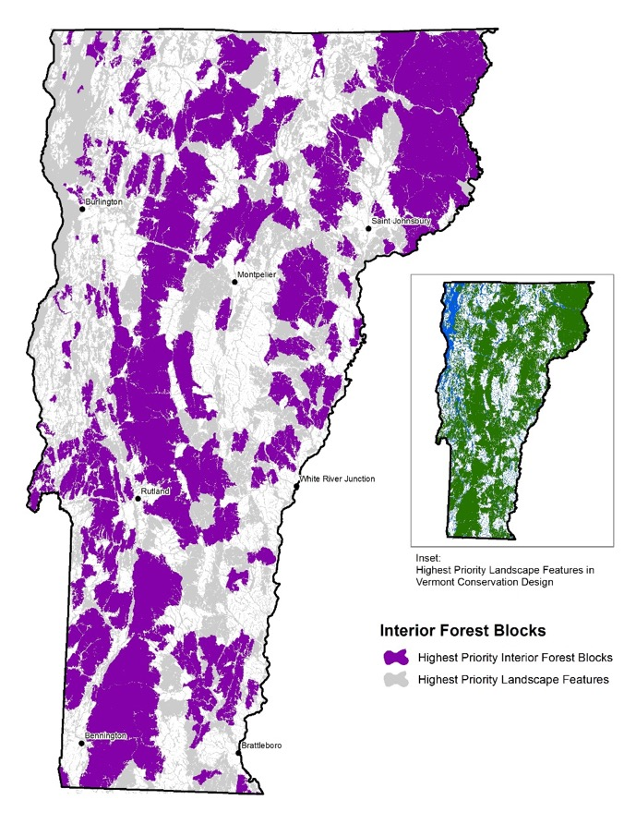
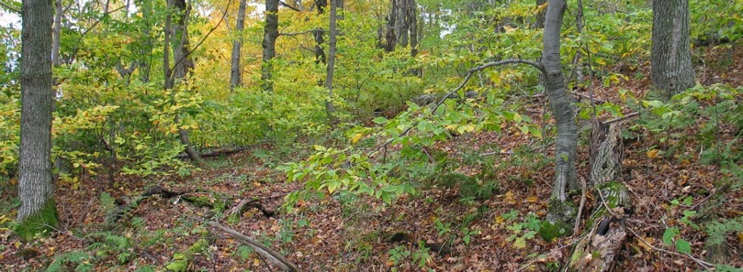
Interior Forest Blocks
The best examples of interior forest in each region of Vermont
Places where species and ecological process exist with minimal disturbance
Ecological functions:
Interior forest species
Wide-ranging mammals
Air and water quality
Flood resilience
Ecological processes
Species can shift and adapt within blocks

Slide 14
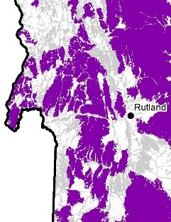
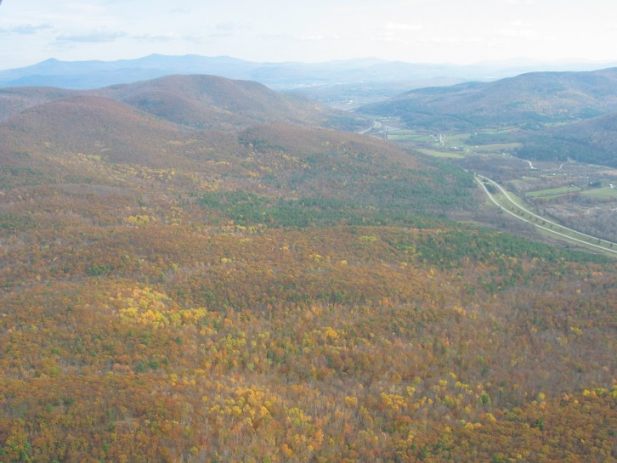
Interior Forest Blocks
Guidelines for Maintaining Ecological Function:
Avoid permanent interior fragmentation
Limit development to the margins
Maintain forest structure & distribution of age classes
Minimize invasive species.

Slide 15
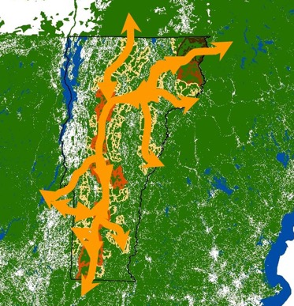
Connectivity Blocks
The network of forest blocks that are critical for wildlife movement and species ranges shifts
Connects within Vermont and to adjacent states and Québec
Ecological Functions:
Wildlife movement and dispersal
Habitat for wide-ranging mammals
Genetic exchange
Plant and animal range shifts in response to climate change
Reduces extinction risks

Slide 16
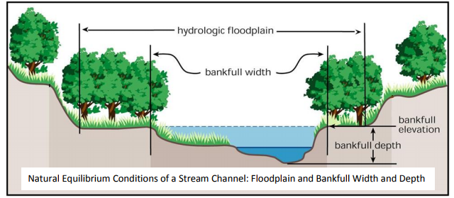
Surface Waters and Riparian Areas
Every river, stream, lake, pond and riparian area in Vermont
Entire network contributes to biodiversity and ecological function
Ecological Functions:
Habitat for aquatic species
Water quality
Flood protection
Terrestrial species habitat
Wildlife movement
Plant and animal range shifts in response to climate change

Slide 17
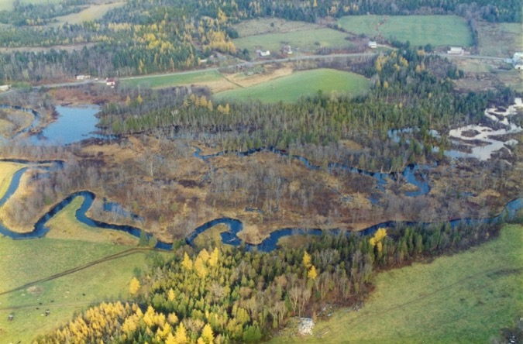
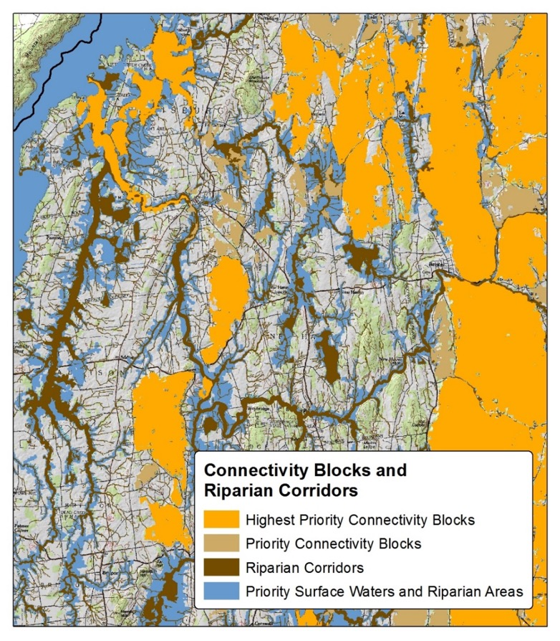
Riparian Connectivity
In parts of the state, riparian areas are the only connections between forest blocks
We need to restore riparian vegetation.

Slide 18
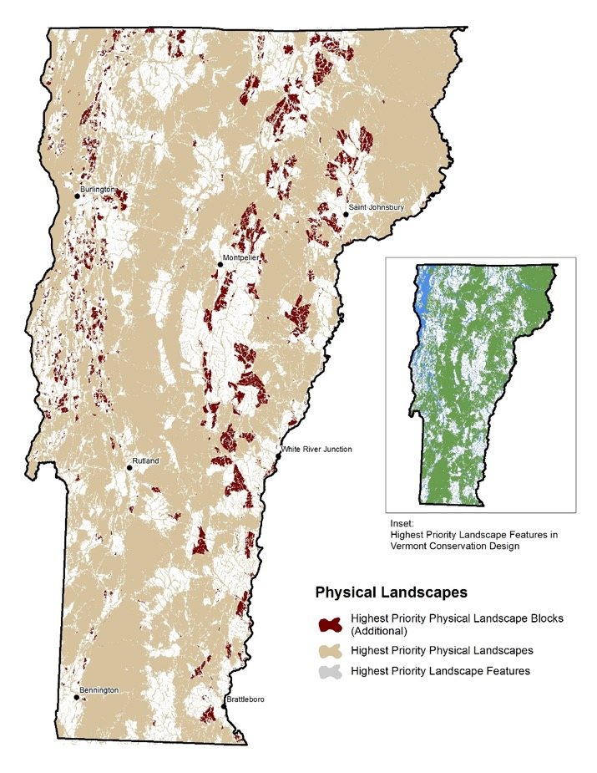
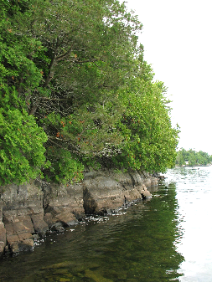
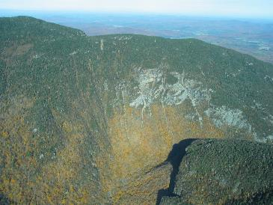
Physical Landscape Diversity
A set of forest blocks that ensure we conserve Vermont’s full diversity of elevation, geology, and landforms
“Conserve nature’s stage”
Ecological functions:
Habitat for species that use specific physical settings (e.g. those found on calcium-rich rock)
Species can shift to new settings in a changing climate

Slide 19
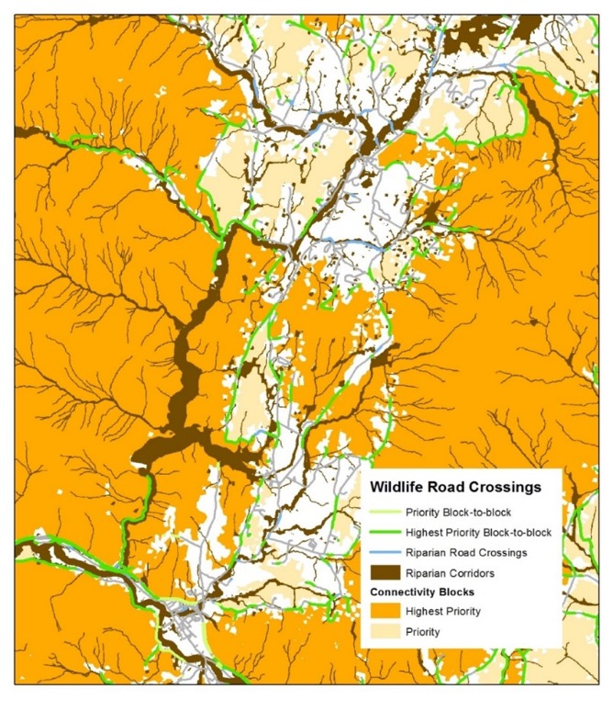
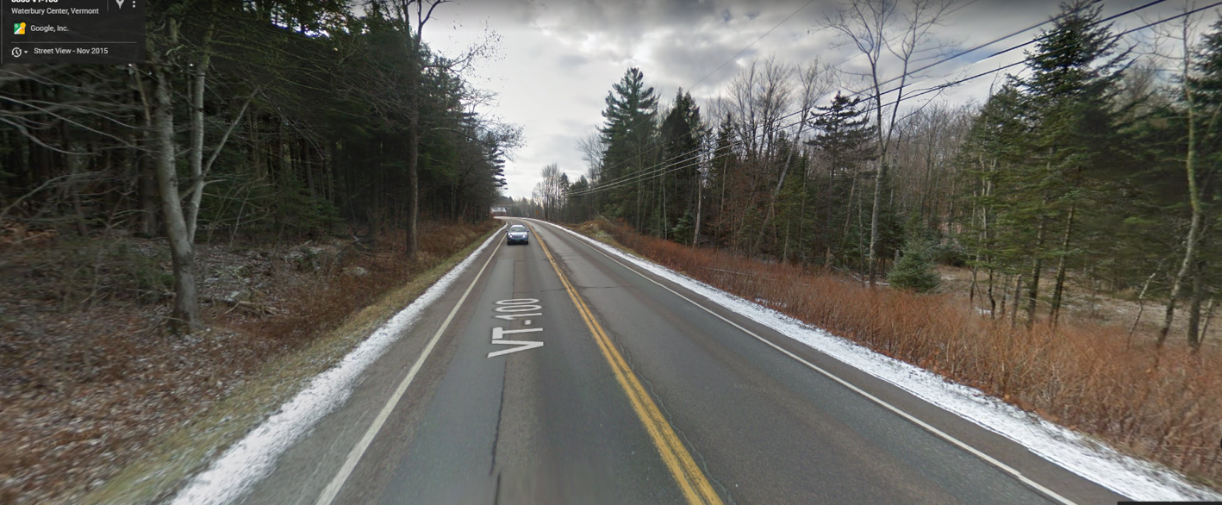
Wildlife Road Crossings

Slide 20
Conservation Design at Three Scales
Landscapes
Natural Communities
Species
Interior Forest Blocks
Connectivity Blocks
Surface Waters and Riparian Areas
Riparian Areas for Connectivity
Physical Landscapes
Wildlife Road Crossings
Natural Communities
Young and Old Forest
Aquatic Habitats
Wetlands
Grasslands/Shrublands
Underground Habitats
Species with very specific biological needs that will likely always require individual attention
Notes:
Review use of table to identify which species and natural communities are “captured” by each landscape element – refining the elements

Slide 21
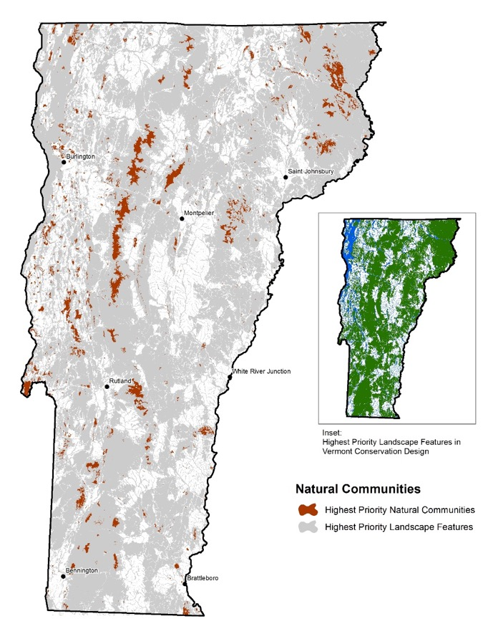
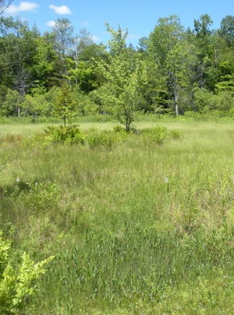
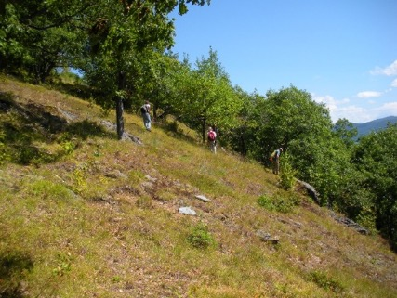
Natural Communities
Vermont’s original natural habitats
All examples of rare types and 50% of the examples of more common types
Matrix forests conserved by forest blocks and old forests
Ecological Functions:
Coarse filters for the majority of our native species
Places that will always support unique assemblages of biodiversity, even in a changing climate

Slide 22
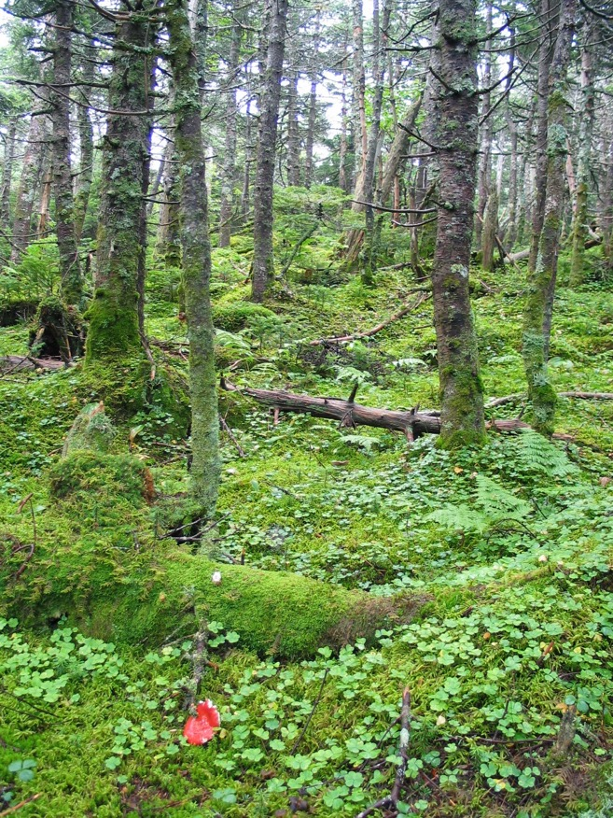
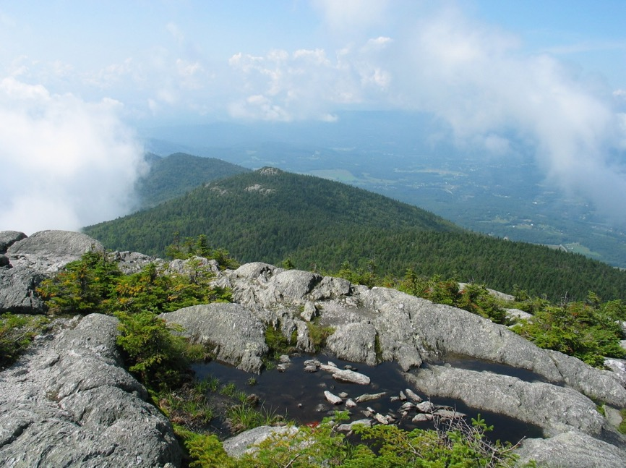

Slide 23
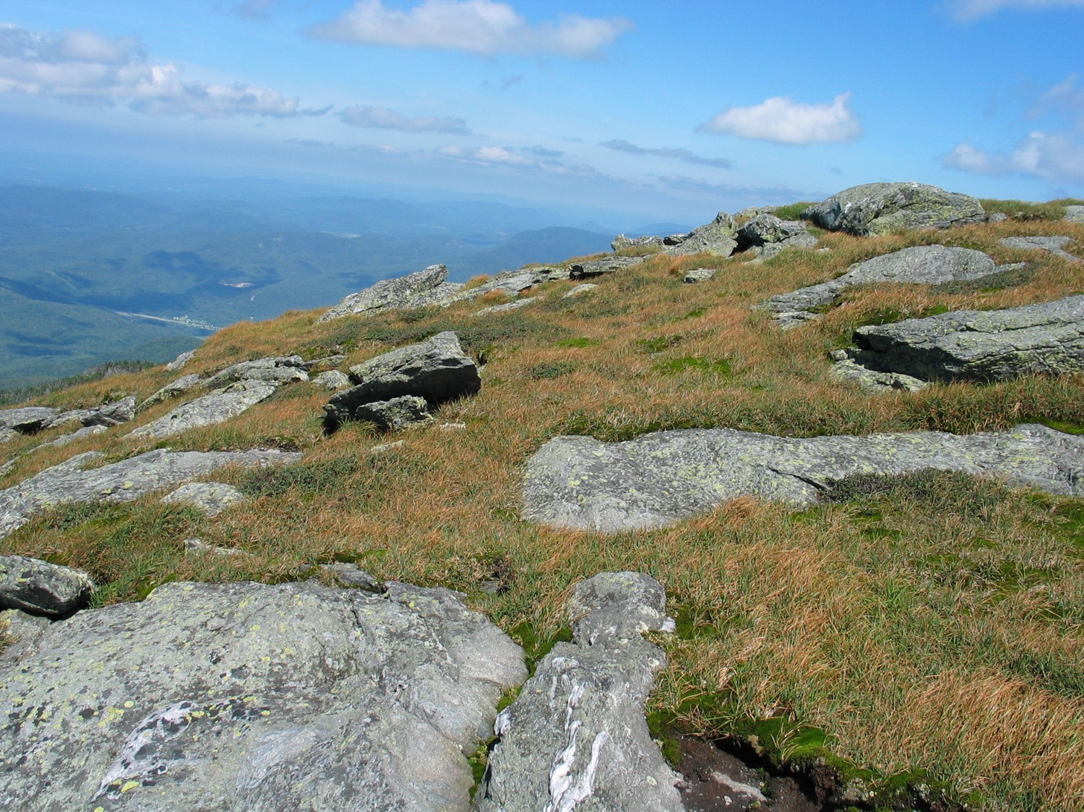

Slide 24
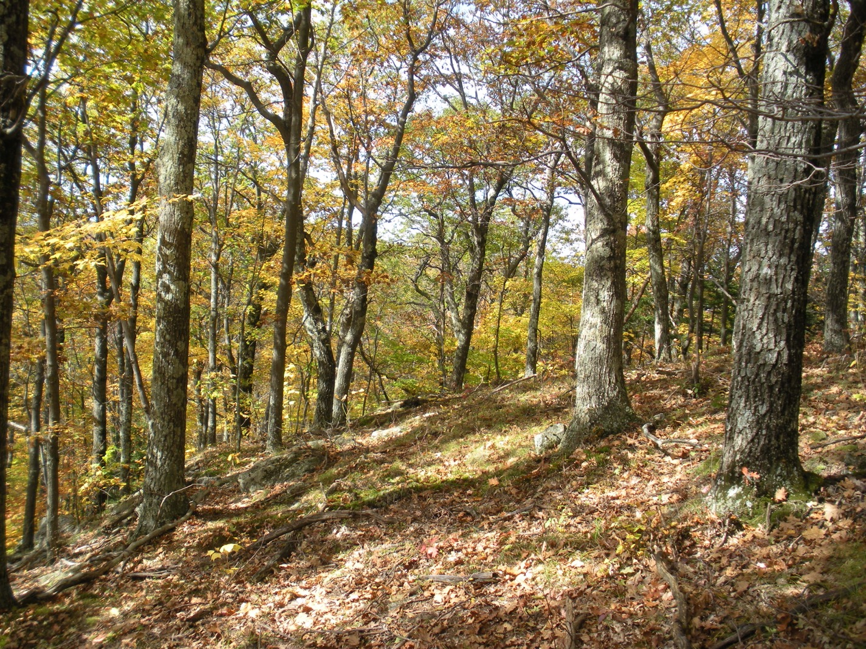

Slide 25
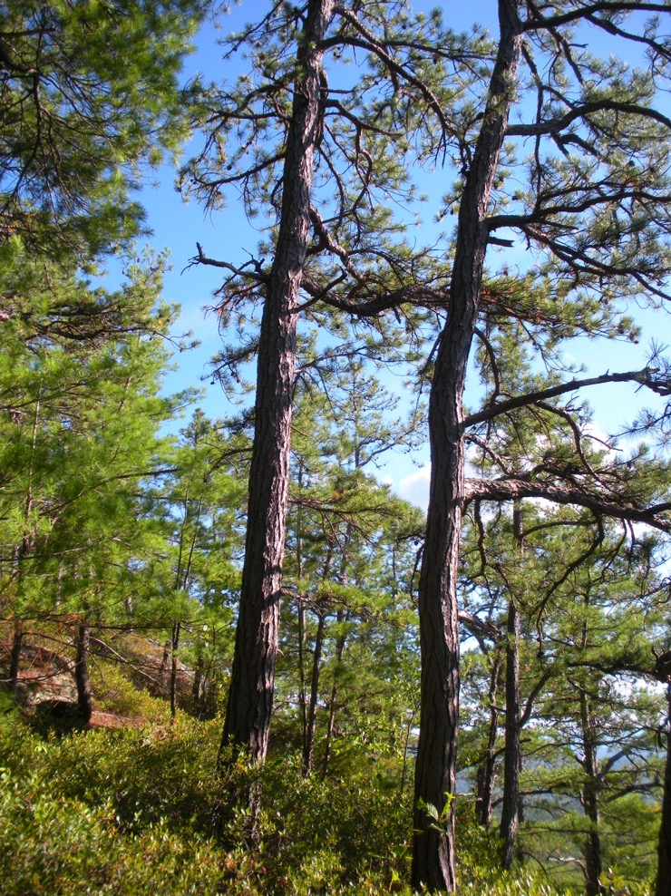
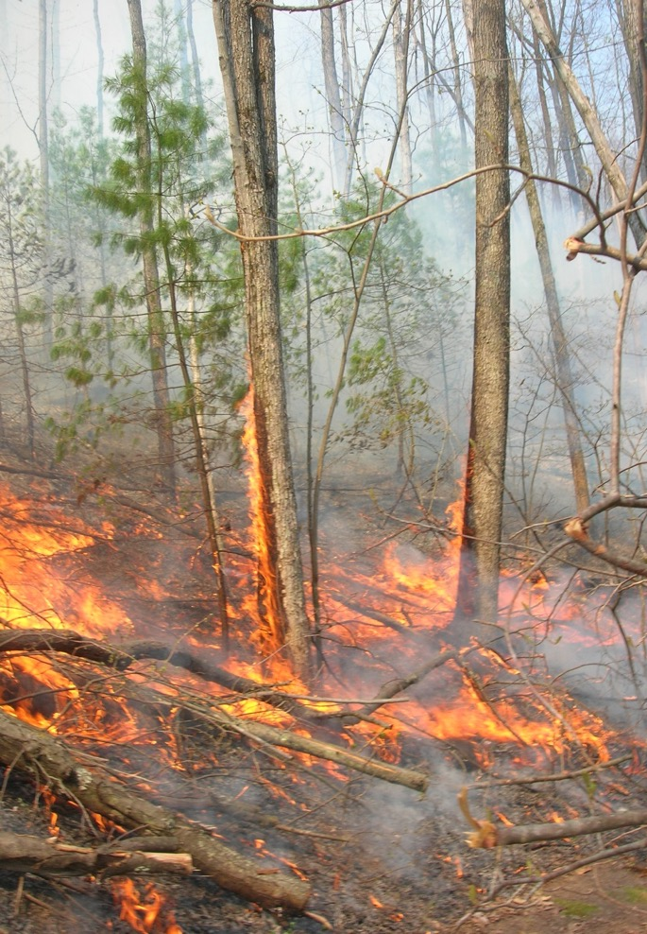

Slide 26
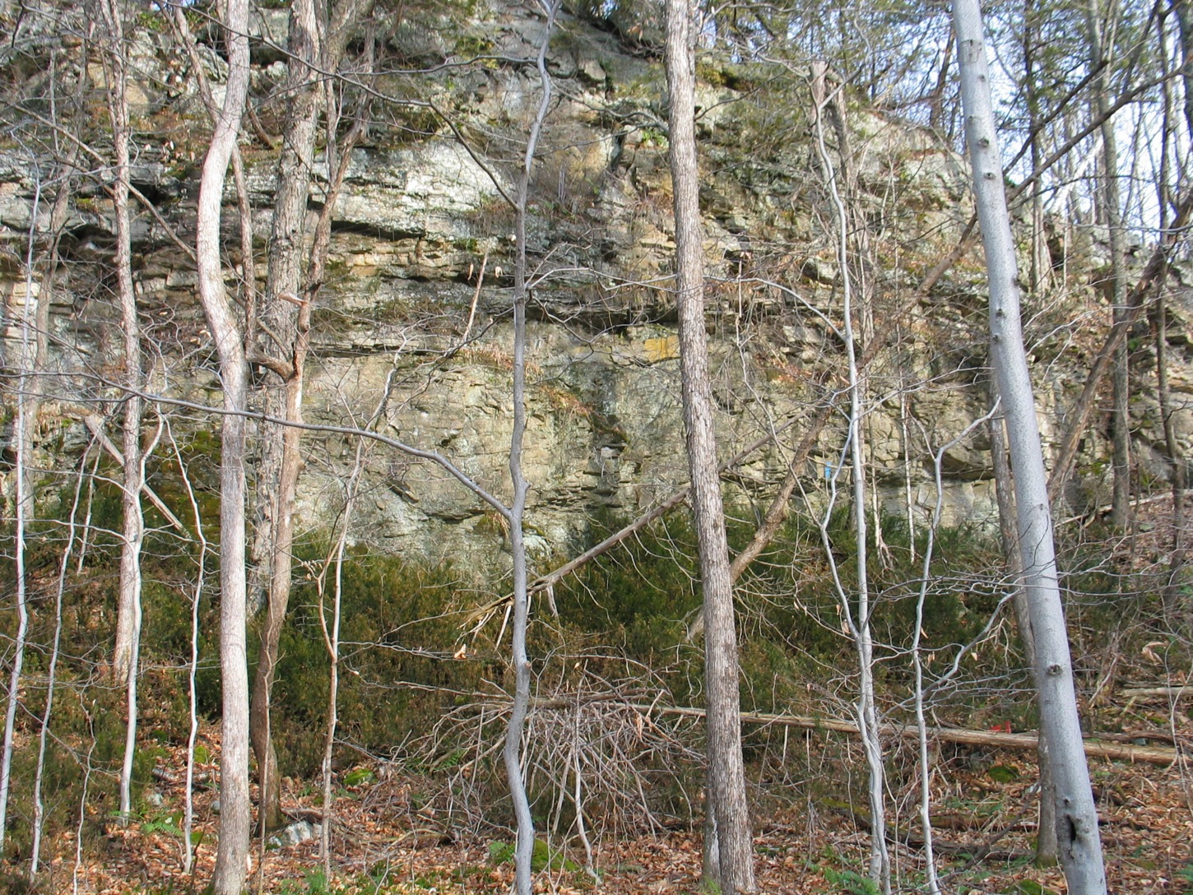

Slide 27
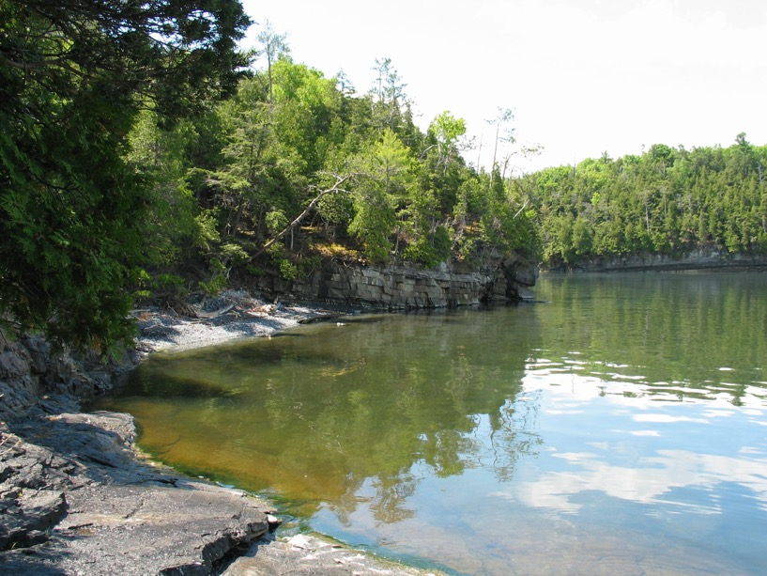

Slide 31
Young and Old Forests
Young and old forests support a great diversity of species and ecological processes
Target of 3-5% young forest and 10% old forest, distributed across Vermont and proportional to matrix forest types
Ecological Functions:
Young forests are habitat for many wildlife species, especially birds
Old forests have complex and diverse habitats, contribute to clean air and water, and are particularly resilient to change

Slide 32
Aquatic Habitats
The river and stream segments, and lakes and ponds that make unique contributions to biological diversity
Need to be conserved as part of the larger network of surface waters and riparian areas
Ecological Functions:
Habitat for rare and specialist species
Conserve the stage (physical diversity) of aquatic systems
Cold water refugia

Slide 33
Wetlands
Vermont’s wetlands provide irreplaceable habitats and ecological functions
Almost all of Vermont’s wetlands and vernal pools are highest priority
Ecological Functions:
Fish and wildlife habitat
Many rare species are found only in wetlands
Flood protection
Water quality
Ground water protection

Slide 34
Grasslands and Shrublands
Grasslands and shrublands are man-made habitats that support a unique set of species
Many bird species that need grasslands or shrublands are in regional decline
“Lifeboat” of 7,500 acres to ensure these species remain in Vermont
Ecological Functions:
Supports a suite of grassland-nesting and shrubland nesting birds
Habitat that has been lost in other parts of the country

Slide 35
Underground Habitats
Caves and mines are our subterranean natural communities
We know much about the bats that use these places, but invertebrates, fungi, algae, and other species are likely present as well
A set of caves and mines, but not mapped so we can protect sensitive sites
Ecological Functions:
Supports hibernating bats and likely many other species
Habitat that has been lost in other parts of the country

Slide 36
Conservation Design at Three Scales
Landscapes
Natural Communities
Species
Interior Forest Blocks
Connectivity Blocks
Surface Waters and Riparian Areas
Riparian Areas for Connectivity
Physical Landscapes
Wildlife Road Crossings
Natural Communities
Young and Old Forest
Aquatic Habitats
Wetlands
Grasslands/Shrublands
Underground Habitats
Species with very specific biological needs that will likely always require individual attention
Notes:
Review use of table to identify which species and natural communities are “captured” by each landscape element – refining the elements

Slide 37
Northern pale painted cup
(Castilleja septentrionalis)

Slide 38
Spiny softshell turtle

Slide 39
Vermont Conservation Design
Maintains an intact, connected and diverse natural landscape
Conserves species and natural communities
Allows nature to adapt to a changing climate

Slide 40
Home…
Center-West Ecoregion

Slide 41
Home…
Center-West Ecoregion

Slide 42
Conserved Lands
Home…
Center-West Ecoregion

Slide 43
The Ecologically Functional Landscape
Home…
Center-West Ecoregion

Slide 44
Highest Priority Blocks
Home…
Center-West Ecoregion

Slide 45
Connectivity
Home…
Center-West Ecoregion

Slide 46
Connectivity
Home…
Center-West Ecoregion

Slide 47
Connectivity
Home…
Center-West Ecoregion

Slide 48
Rare Species and Significant Natural Communities
Home…
Center-West Ecoregion

Slide 49
Sustains more than biodiversity
Outdoor recreation
Clean water
Sense of place and rural character
Working farms and forests
Nature’s benefits

Slide 50
Some Thoughts and Perspectives
Vision for the future of Vermont.
Landowners and their decisions are key to success.
All the features are needed for ecological function.
Unifies many aspects of conservation, without being prescriptive.
Supports Vermont’s social and economic values.
Photo by
Susan Morse

Slide 51
Thank you… Questions?
Home…
Center-West Ecoregion

